Slide 1
Hotel Booking Cancellation Prediction Using AI
Random Forest Model + Flask Deployment

Slide 2
Predict whether a hotel booking will be canceled or not using machine learning.
Python (Pandas, Scikit-learn)
Random Forest Classifier
Flask Web Framework
Google Colab / Replit (Deployment)

Slide 3
Model: RandomForestClassifier Why Random Forest?
Robust to overfitting
Works well with categorical + numerical data
Easy to interpret
Split: 80% training / 20% testing

Slide 4
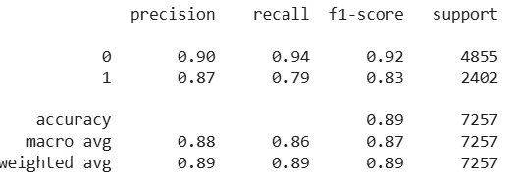
Model Performance
Accuracy: ~89%
Precision, Recall, F1-score: Good balance

Slide 5
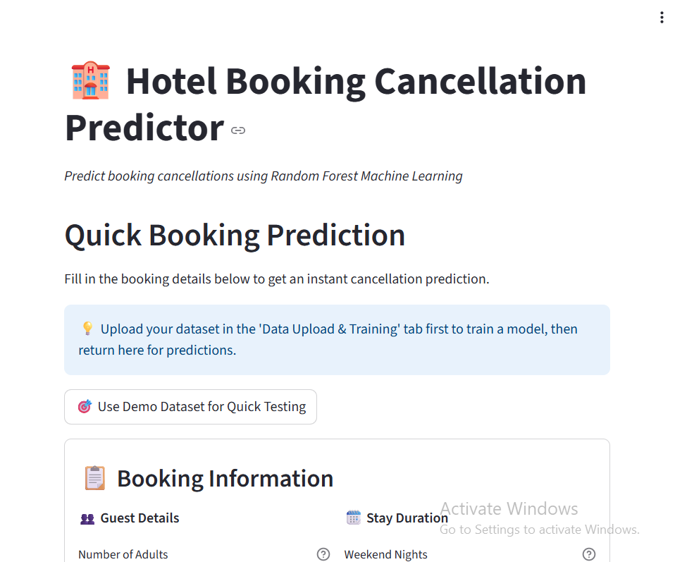
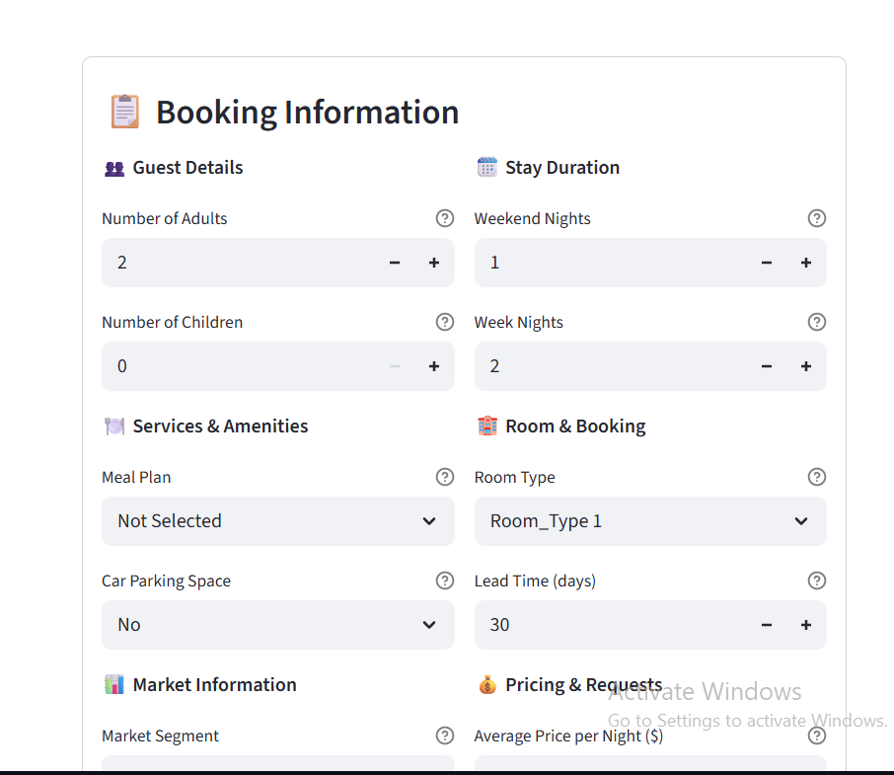
Deployment Demo Screenshot

Slide 6
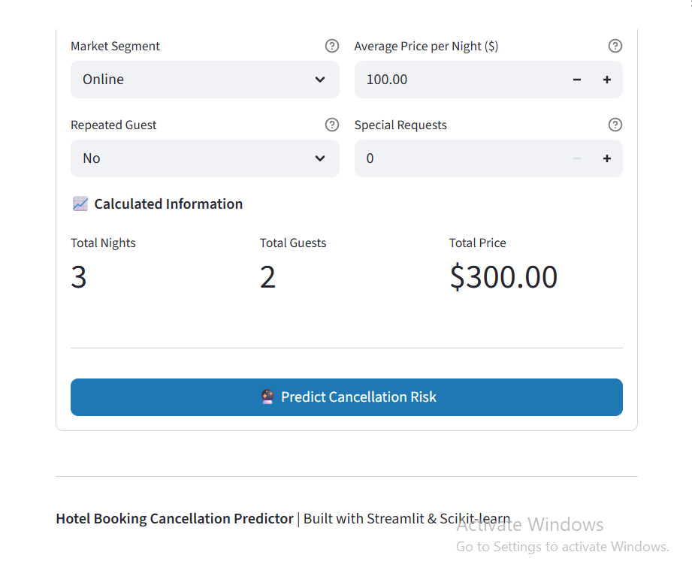
Deployment Demo Screenshot

